Slide 1
Data system for monitoring air quality Aarhus University Environmental Science (ENVS) Keld S Mortensen
Agenda
About the air quality section at ENVS
Airpollution and health
Stations
Measured compounds
Dataflow
Stations and instruments
Bertha ”Big Data” project

Slide 2
About the air quality section at ENVS
Placed 7 km north of Roskilde, east side of Roskilde Fjord (Risø campus)
Main task: To do science based authority service
European UNION -> Ministry of Environment and Food -> Aarhus University
Measurement of air quality
Calculates emissions
Develop air models
Examples of other projects (based on private founding)
Villum Research Station (Villum foundation 70 mio. kr), Big Data center (Novo Nordic foundation 60 mio. kr)

Slide 3
Outdoor airpollution and health
Worldvide (year, WHO 2017):
3.0 mio. premature death
70% because of particle pollutions
30% because of ozone and NOx-gases
Denmark (year):
3000 premature death
About 80% of those deaths are due to heart disease and stroke, while another 20% are from respiratory illnesses and cancers related to exposure to fine particulate
Climate changes ?

Slide 4
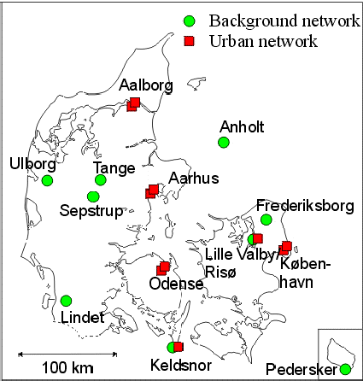

Stations

Slide 5
Measured compounds
Examples:
Gasses (Ozone, Sulfur dioxide, Nitrogen oxides, Carbon oxides, Carbon dioxide, Methane)
Particles (Pm10, Pm2.5, Sizedistribution).
Organic compounds (PAH, Benzene, Dioxins)
Unorganic compounds (Ammonia, Sulfur, Heavy metals)
PM10 = 10 µm = 0.01 mm
PM2.5 = 2.5 µm = 0.0025 mm
Meterorology (VS,VD,RH,Temp, Prep)

Slide 6
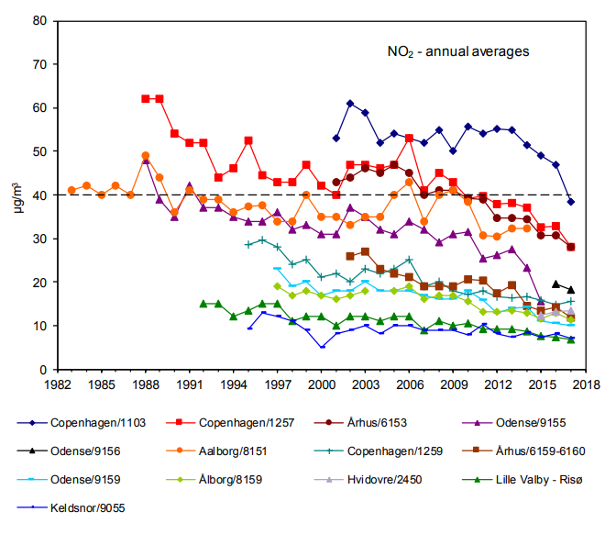
Limit year mean:
40 µg/m3

Slide 7
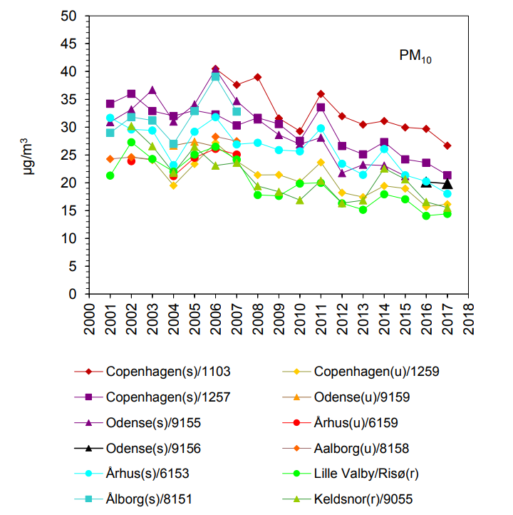
Limit year mean:
40 µg/m3

Slide 8
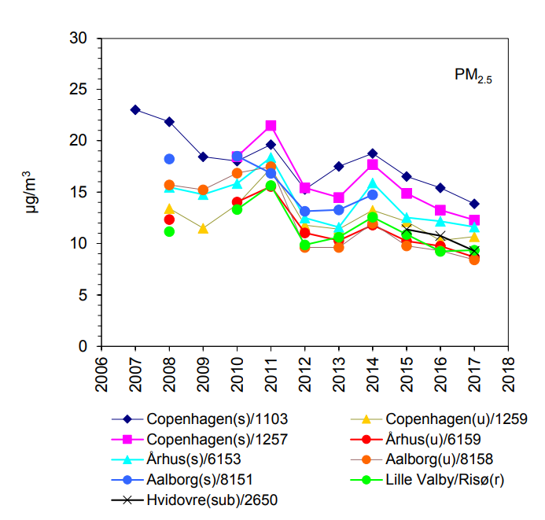
Limit year mean:
25 µg/m3

Slide 9
Data flow
Snow samples
Samples (filters)
Stations
To laboratory
Samples (water)
Laboratories
analyzes
Textfiles
3G/Iridium
File server
Textfiles
Data reporting
EEA
EMEP
Miljøstyrelsen (part of Environmental ministry)
Municipalities
Database
Quality control
Data presentation
Danmarks Miljøportal
AU Webserver
TextTV
Data exchange
Researchers
Students
Models
Data assimilation

Slide 10
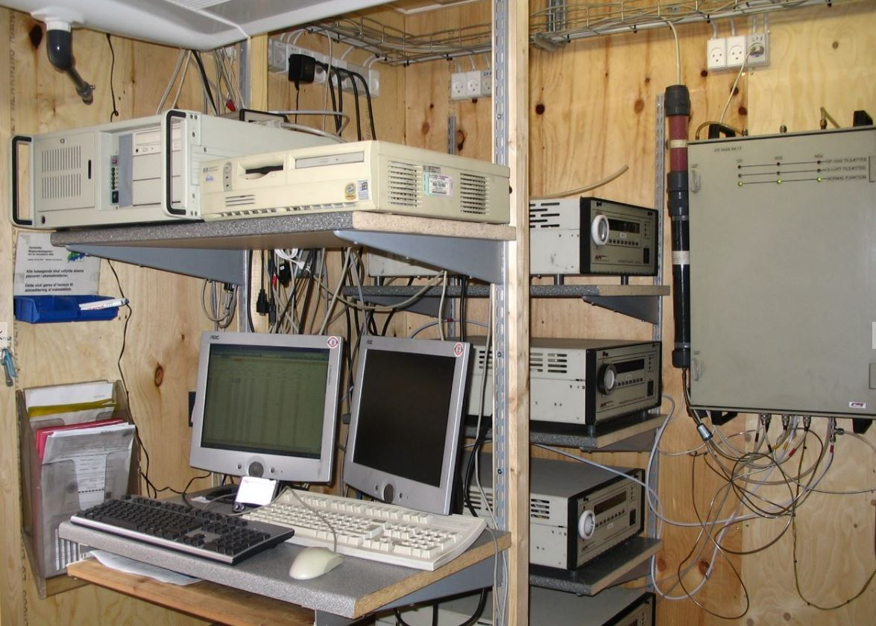
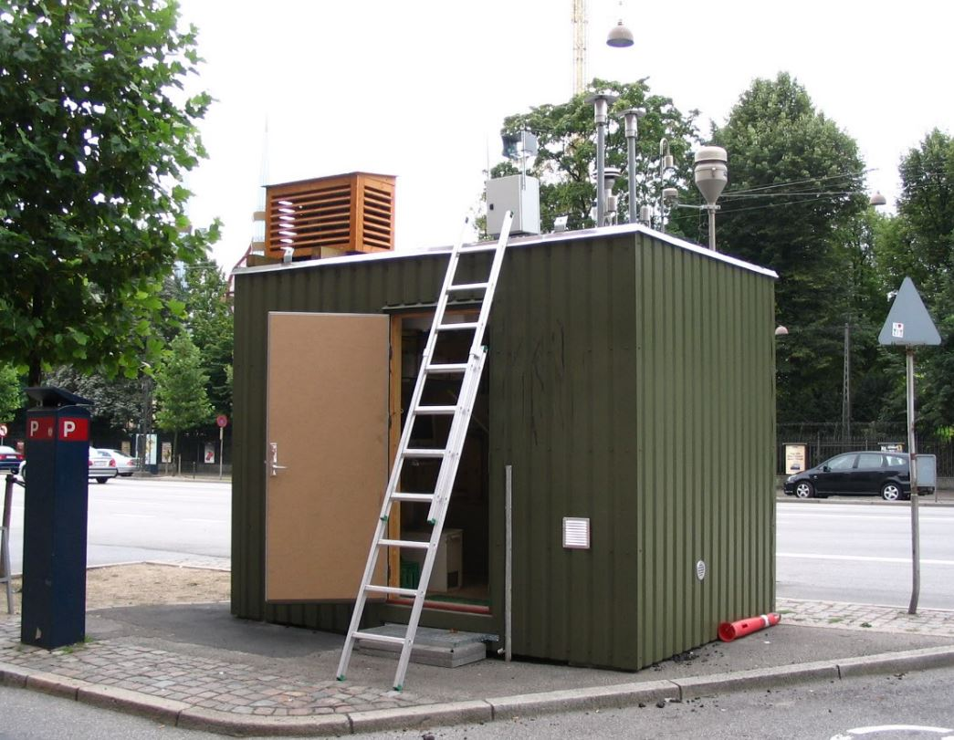
Stations and instruments

Slide 11
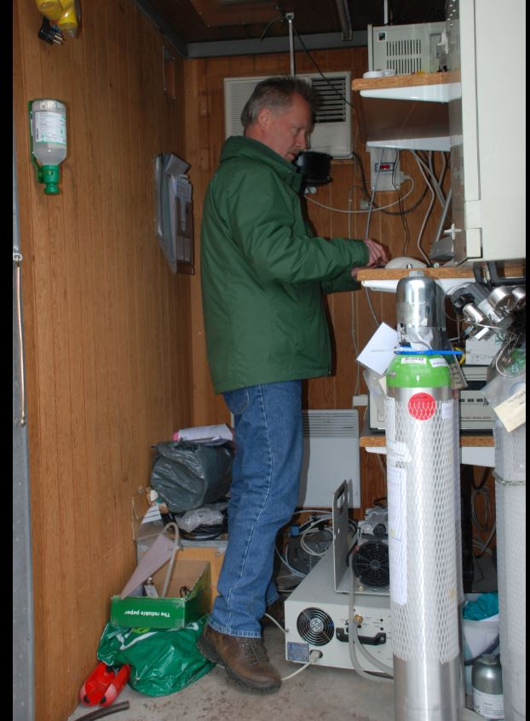
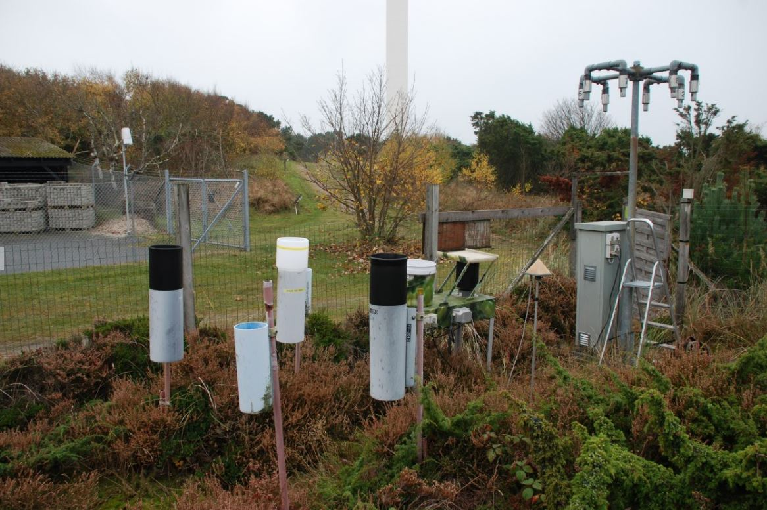
Stations and instruments

Slide 12
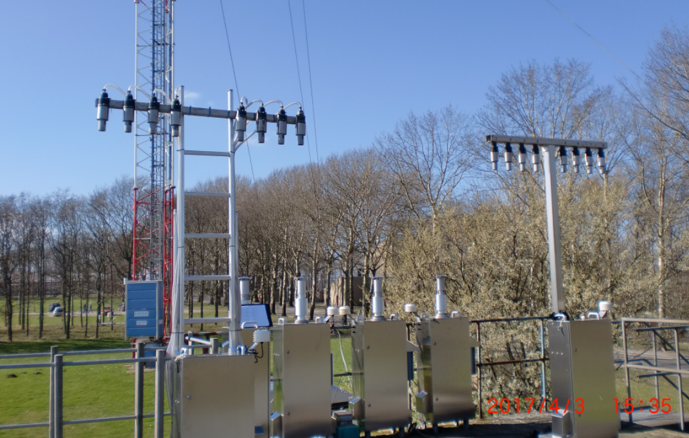
Risø air measurement station

Slide 13
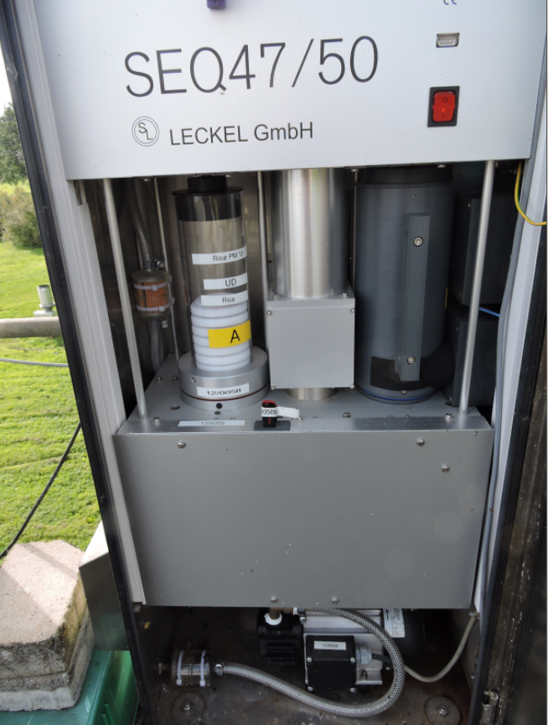
Particle Low Volume Sampler

Slide 14
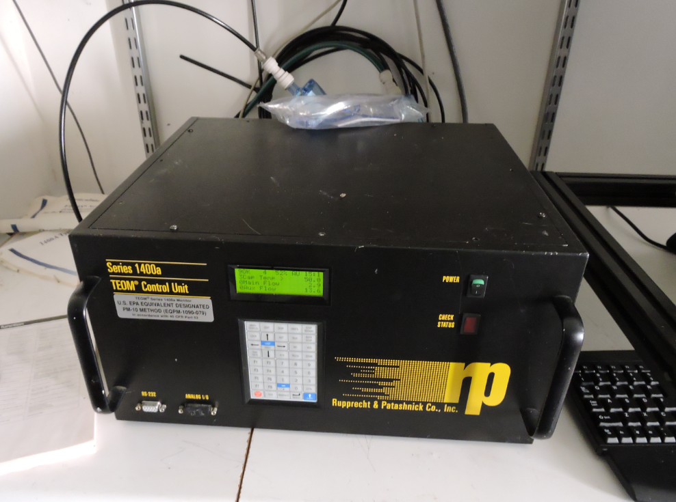
Teom particle sampler

Slide 15
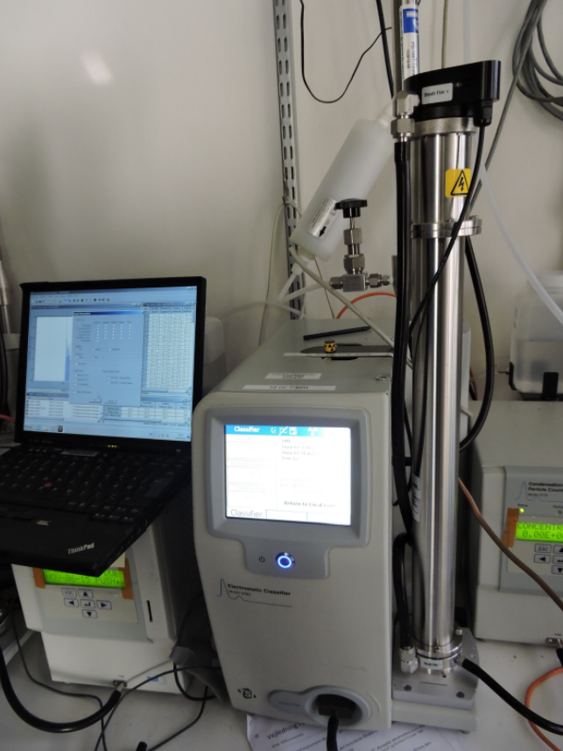
Scanning Mobility Particle Sizer

Slide 16
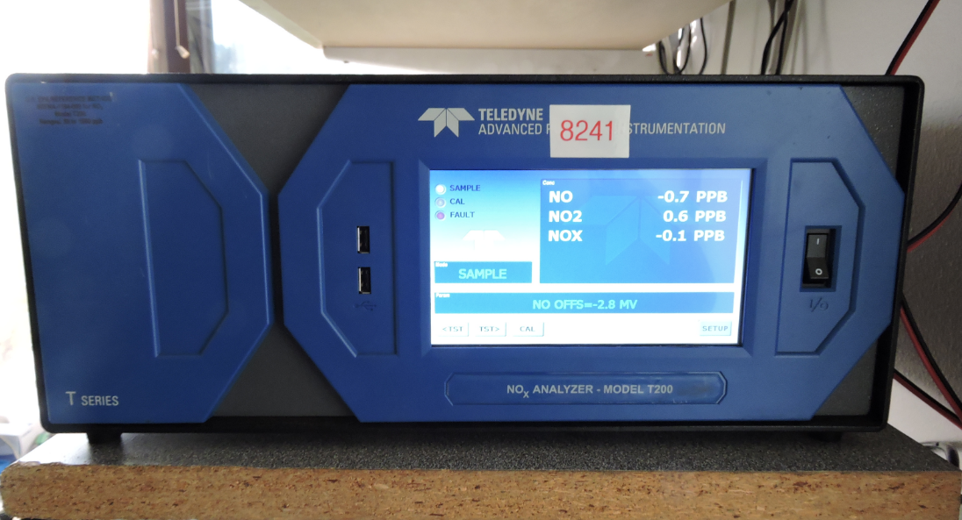
NOx gas monitor

Slide 17
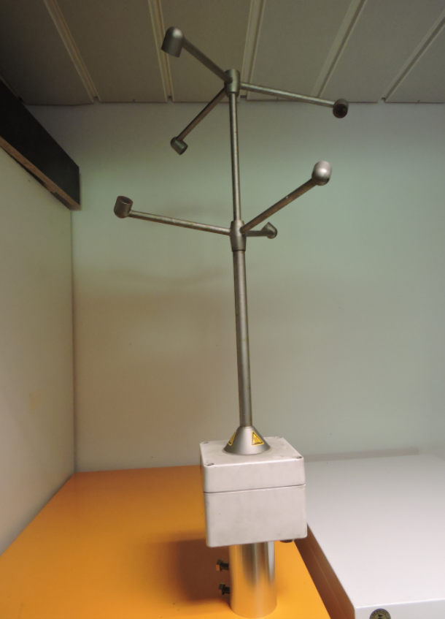
Sonic Anenometer

Slide 18
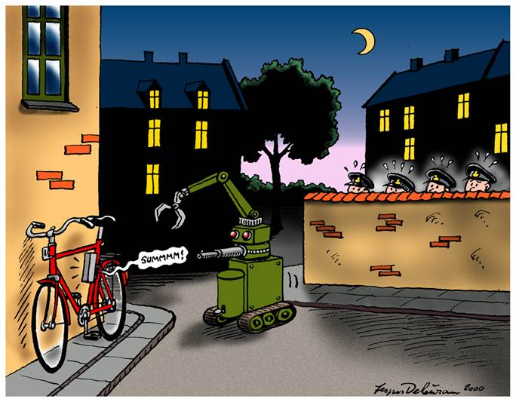
”Rulle Marie” in action

Slide 19
Bertha ”Big Data” Project
60 mio. DKr project (Novo Nordisk Foundation)
Enviromental social science.
The centre will combine disciplines and, taking its outset in large amounts of environmental and health data, it will compare information on health, the environment, lifestyle and behaviour on social media
Measurements of air quality/position using low cost sensors (200 personal sensors)
Collecting data from health, CPR, blood donor registers (among others)
Collect personal data ( lifestyle and behaviour on social media)

Slide 20

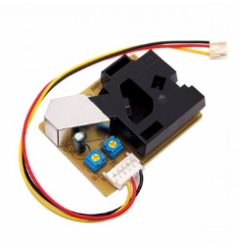
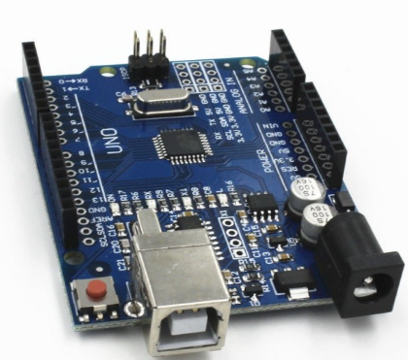
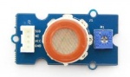
Bertha Project (big data)
Low Cost Sensors
Arduino boards
Data collected for Big Data System:
Air measurements (Particles, Gasses, positions)
Data from registers (health etc.) and social activities

Slide 21
Some usefull links
Aarhus Universitet
Institute for Environmental Science
Air Quality Report 2017
Air Quality Directive (EU)
Air Quality Limits (EU)
Near online data
Web API (gases,particles,meteorologi)
Station Nord meteorology online
Danmarks Miljøportal
Data og doc i dropbox

